Slide 1
CREDIT EDA CASE STUDY
By Prasad Maharana
and
Satyapal Rajput

Slide 2
Data Cleaning – I Application Data
The initial Dimension was 122 columns and 307511 rows
After checking missing values, 64 rows had more than 30% missing rows so they were dropped
The Amt_annuity column had around 3% nulls, so they were replaced with median of Annuity column
Additionally, 33 unwanted columns were dropped which added no significance to the analysis.
In code Gender column, 4 rows were missing gender attribute which was replaced with Female which had the highest count.
18% of the Organization Column had missing attributes which were dropped since they wouldn’t affect the analysis.
Final Clean data contained 30 Columns and 252137 rows.

Slide 3
Categorical Univariate analysis for timely paying Customers or Target 0

Slide 4
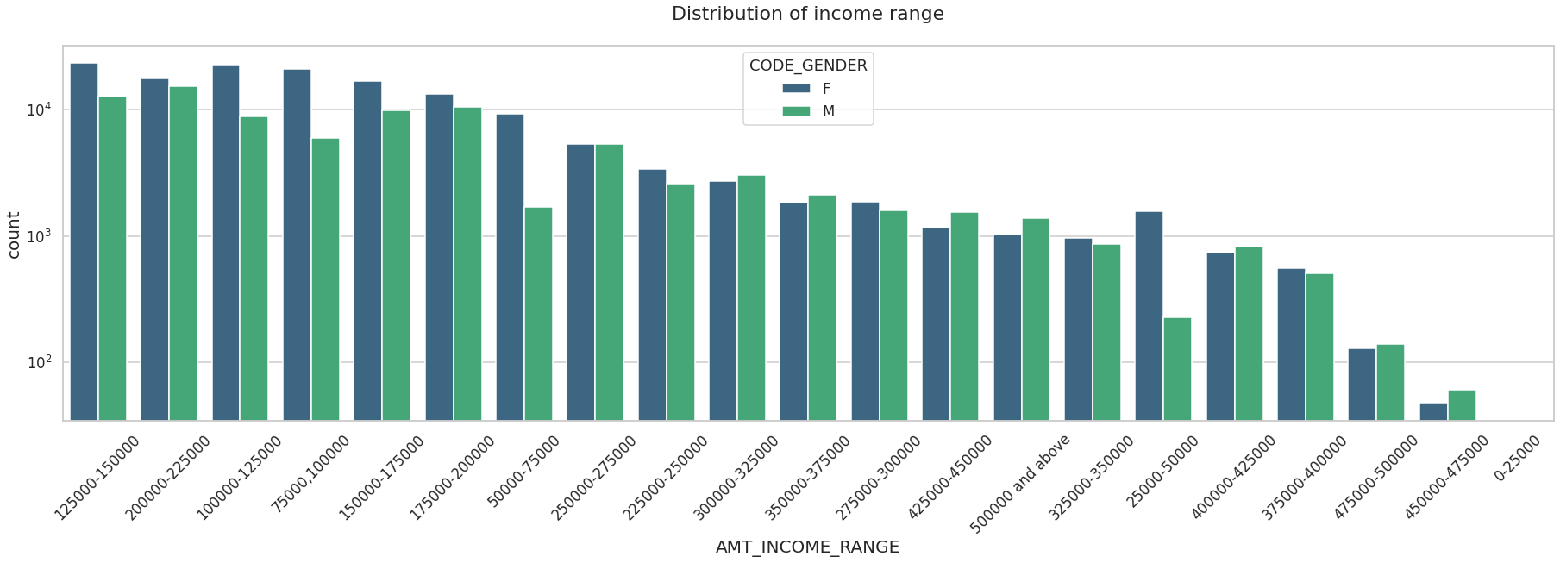
Distribution of Income range
Points to be concluded from the graph on the right side.
Female counts are higher than male.
Income range from 100000 to 200000 is having a greater number of credits.
This graph show that females are more than male in having credits for that range.
Very less count for income range 400000 and above.

Slide 5
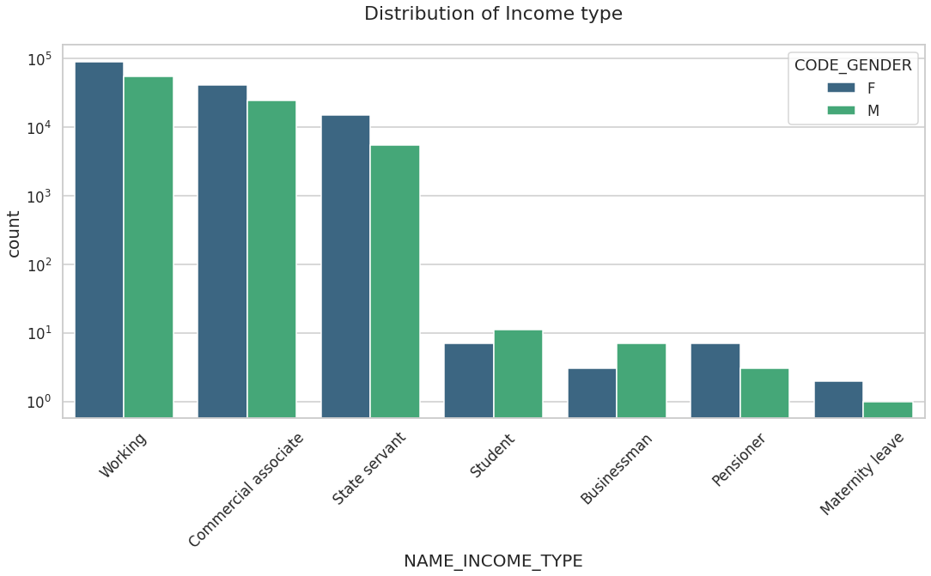
Distribution of income type
Points to be concluded from the graph on the right.
For income type ‘working’, ’commercial associate’, and ‘State Servant’ the number of credits are higher than others.
For this Females are having a greater number of credits than male.
Less number of credits for income type ‘student’ ,’pensioner’, ‘Businessman’ and ‘Maternity leave’.

Slide 6
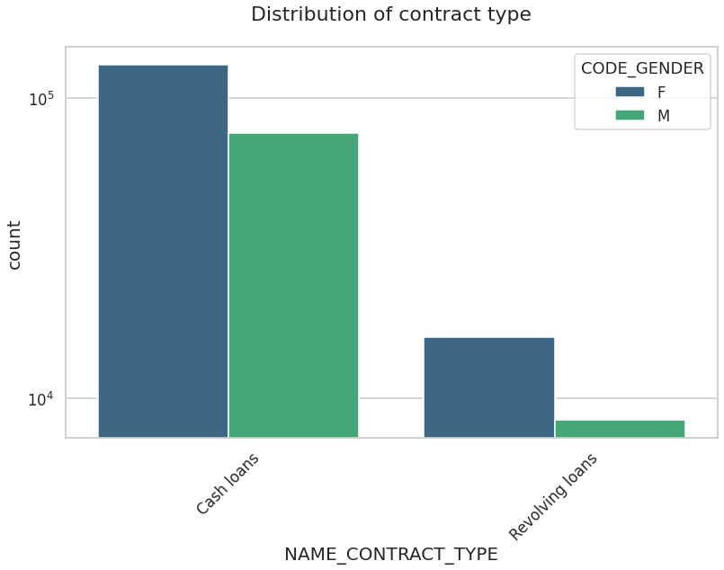
Distribution for contract type
Points to be concluded from the graph on the right.
For contract type ‘cash loans’ is having higher number of credits than ‘Revolving loans’ contract type.
For this also Female is leading for applying credits.

Slide 7
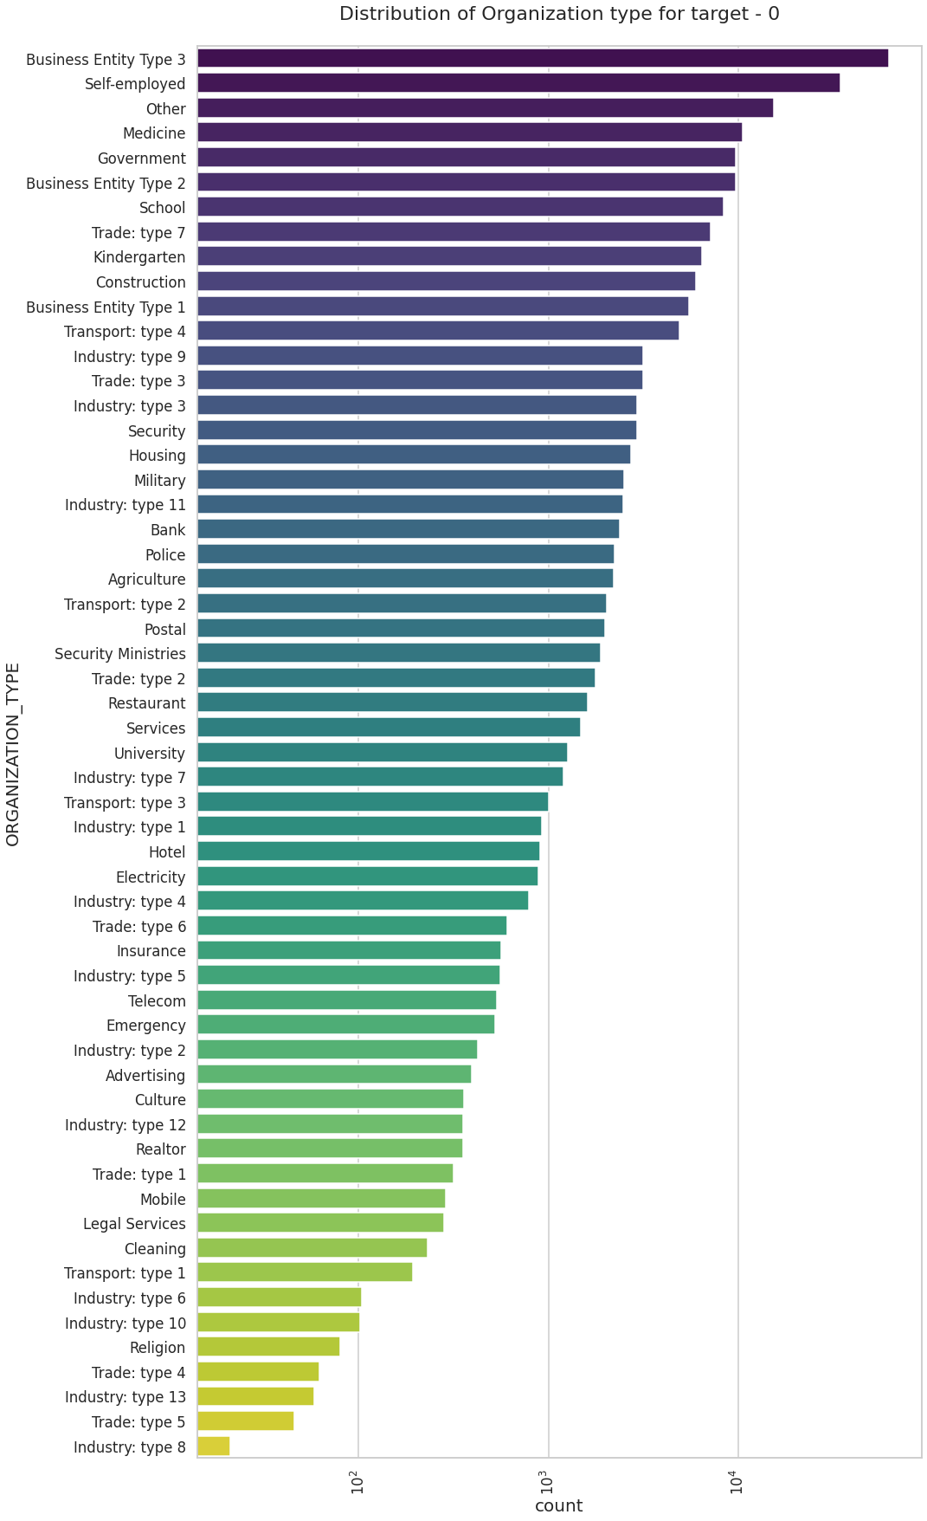
Distribution of organization type
Points to be concluded from the graph on the right.
Clients which have applied for credits are from most of the organization type ‘Business entity Type 3’ , ‘Self employed’ , ‘Other’ , ‘Medicine’ and ‘Government’.
Less clients are from Industry type 8,type 6, type 10, religion and trade type 5, type 4.

Slide 8
Categorical Univariate analysis for defaulting customers (Target 1)

Slide 9
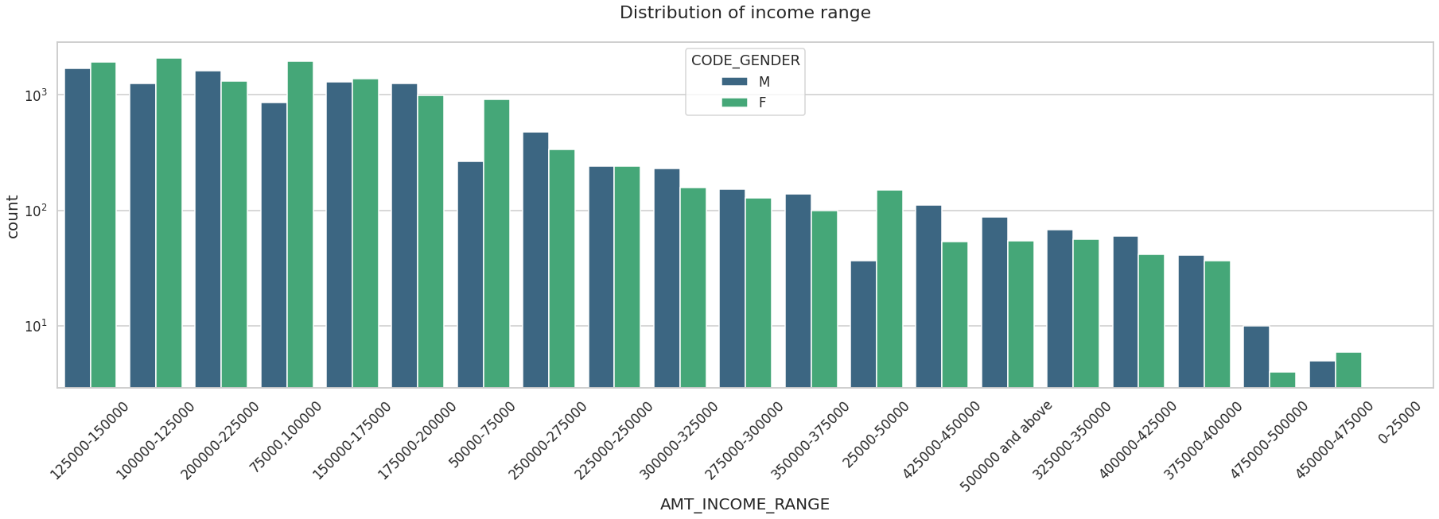
Distribution of Income range
Points to be concluded from the graph on the right side.
Male counts are higher than female.
Income range from 100000 to 200000 is having a greater number of credits.
This graph show that males are more than female in having credits for that range.
Very less count for income range 400000 and above.

Slide 10
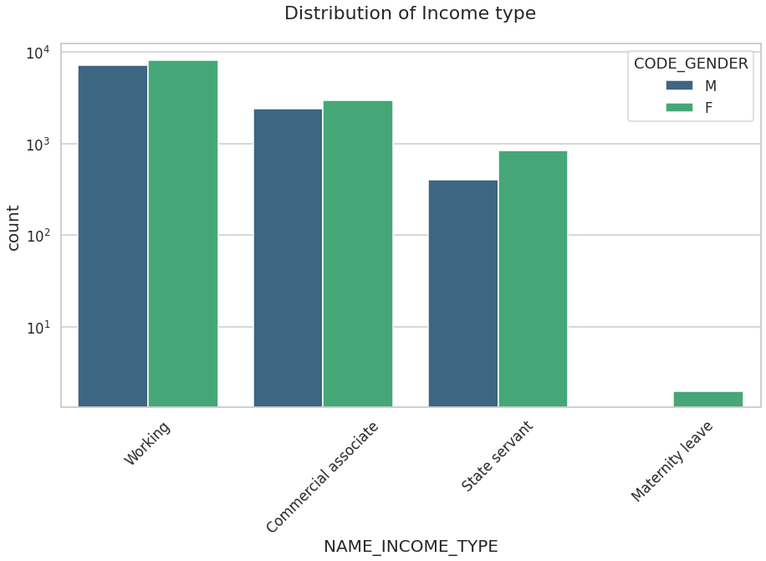
Distribution of income type
Points to be concluded from the graph on the right side.
For income type ‘working’, ’commercial associate’, and ‘State Servant’ the number of credits are higher than other i.e., ‘Maternity leave.
For this Females are having a greater number of credits than male.
Less number of credits for income type ‘Maternity leave’.
For type 1: There is no income type for ‘student’ , ’pensioner’ and ‘Businessman’ which means they don’t do any late payments.

Slide 11
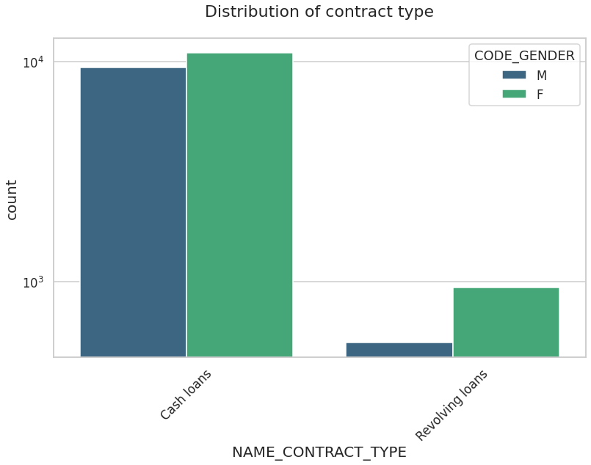
Distribution for contract type
Points to be concluded from the graph on the right.
For contract type ‘cash loans’ is having higher number of credits than ‘Revolving loans’ contract type.
For this also Female is leading for applying credits.
For type 1 : there is only Female Revolving loans.

Slide 12
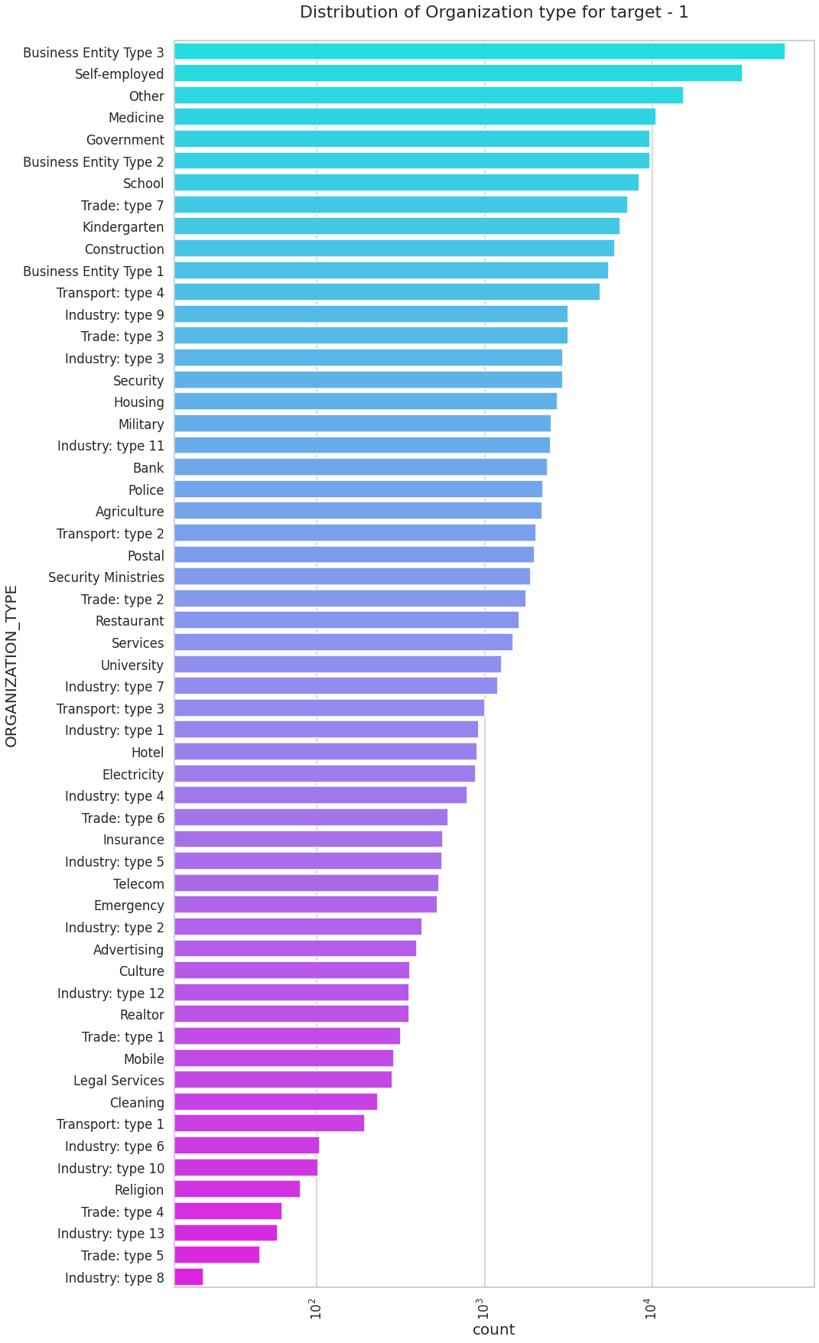
Distribution of organization type
Points to be concluded from the graph on the right.
Clients which have applied for credits are from most of the organization type ‘Business entity Type 3’ , ‘Self employed’ , ‘Other’ , ‘Medicine’ and ‘Government’.
Less clients are from Industry type 8,type 6, type 10, religion and trade type 5, type 4.
Same as type 0 in distribution of organization type.

Slide 13
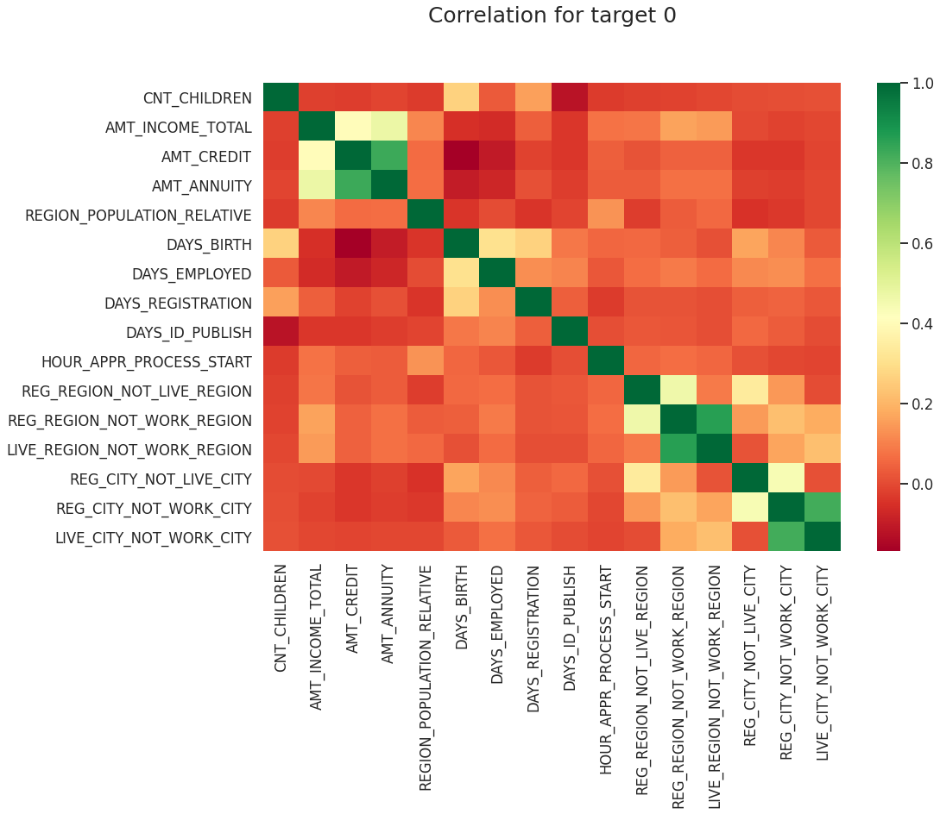
Correlation of Timely Paying customers or target 0
Credit amount is inversely proportional to the date of birth, which means Credit amount is higher for low age and vice-versa.
Credit amount is inversely proportional to the number of children client have, means Credit amount is higher for less children count client have and vice-versa.
Income amount is inversely proportional to the number of children client have, means more income for less children client have and vice-versa.
Less children client have in densely populated area.
Credit amount is higher to densely populated area.
The income is also higher in densely populated area.

Slide 14
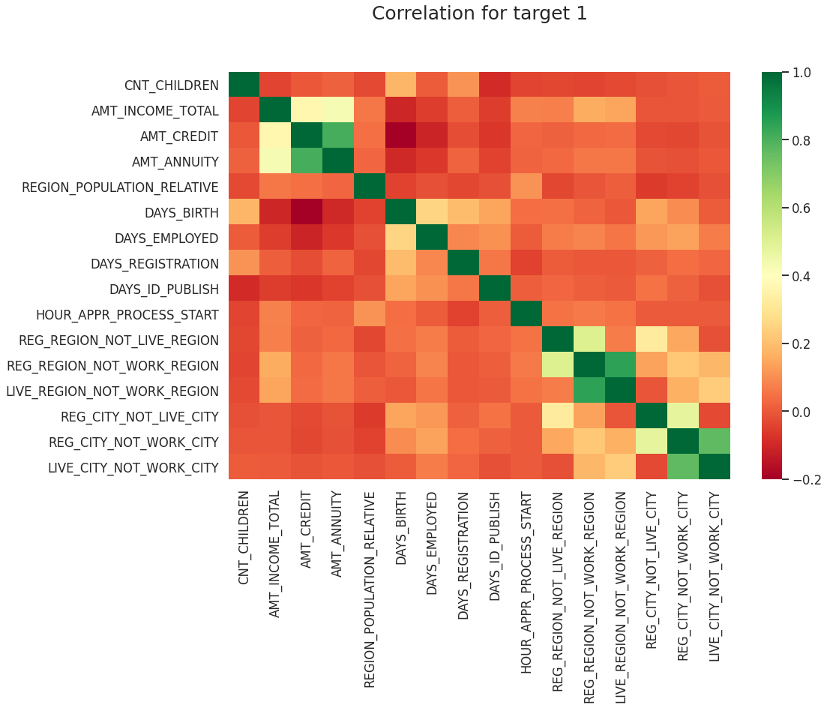
Correlation of defaulting customers or target 1
This heat map for Target 1 is also having quite a same observation just like Target 0. But for few points are different. They are listed below.
The client's permanent address does not match contact address are having less children and vice-versa
The client's permanent address does not match work address are having less children and vice-versa

Slide 15
Categorical Univariate analysis for variables of target 0 or timely paying customers

Slide 16
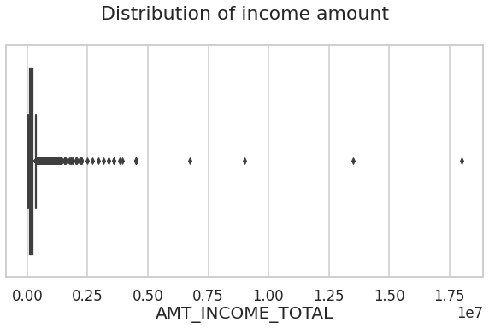
Boxplot for income amount
Few points can be concluded from the graph.
Some outliers are noticed in income amount.
The third quartiles is very slim for income amount.

Slide 17
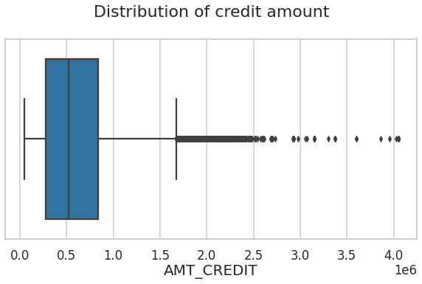
Boxplot for credit amount
Few points can be concluded from the graph.
Some outliers are noticed in credit amount.
The first quartile is bigger than third quartile for credit amount which means most of the credits of clients are present in the first quartile.

Slide 18
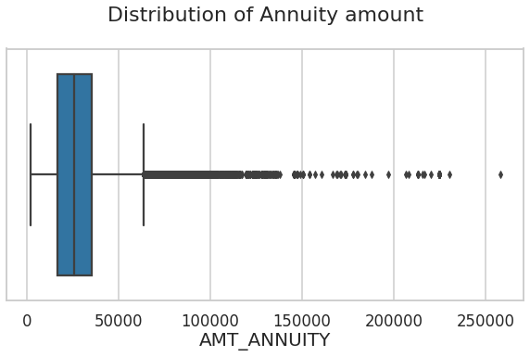
Boxplot for annuity amount
Few points can be concluded from the graph.
Some outliers are noticed in annuity amount.
The first quartile is bigger than third quartile for annuity amount which means most of the annuity clients are from first quartile.

Slide 19
Categorical Univariate analysis for variables target 1 or Defaulting customers

Slide 20
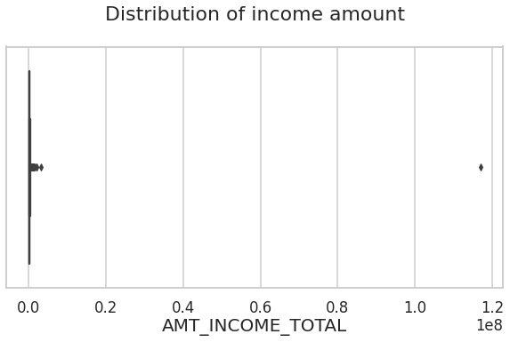
Boxplot for income amount
Few points can be concluded from the graph.
Some outliers are noticed in income amount.
The third quartiles is very slim for income amount.
Most of the clients of income are present in first quartile.

Slide 21
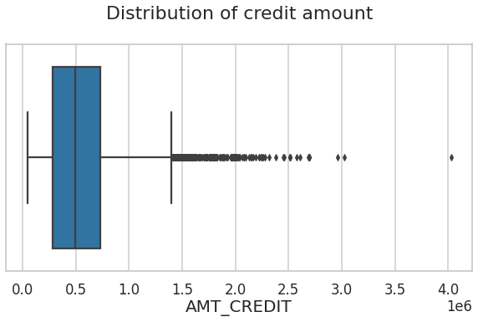
Boxplot for credit amount
Few points can be concluded from the graph.
Some outliers are noticed in credit amount.
The first quartile is bigger than third quartile for credit amount which means most of the credits of clients are present in the first quartile.

Slide 22
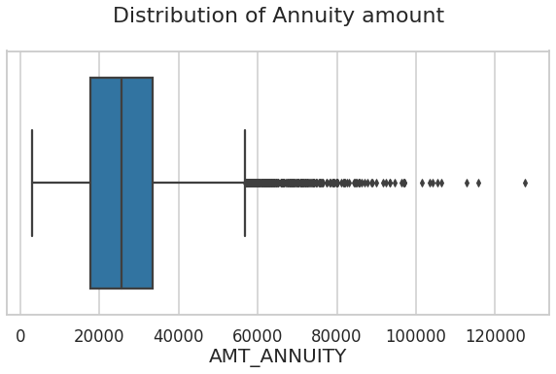
Boxplot for annuity amount
Few points can be concluded from the graph.
Some outliers are noticed in annuity amount.
The first quartile is bigger than third quartile for annuity amount which means most of the annuity clients are from first quartile.

Slide 23
Bivariate analysis for type 0

Slide 24
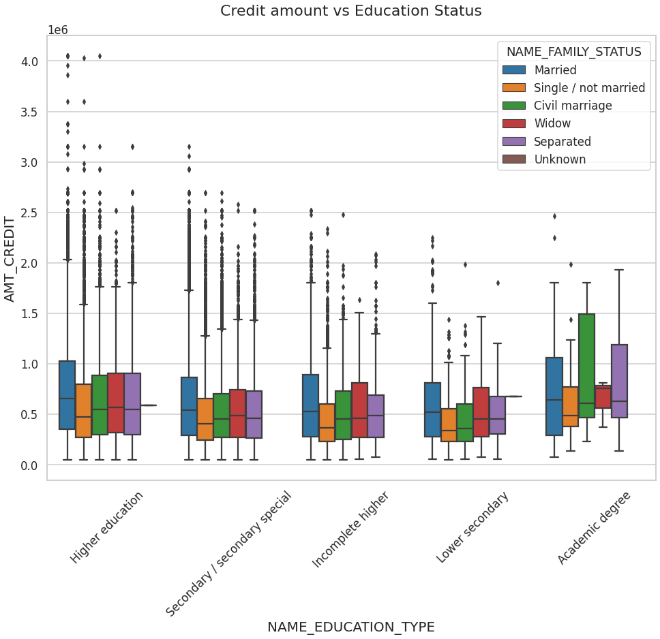
Credit amount vs Education Status
Few points can be concluded from the graph.
Family status of 'civil marriage', 'marriage' and 'separated' of Academic degree education are having higher number of credits than others.
Higher education of family status of 'marriage', 'single' and 'civil marriage' are having more outliers.
Civil marriage for Academic degree is having most of the credits in the third quartile.

Slide 25
Income amount vs Education Status
Few points can be concluded from the graph.
For Education type 'Higher education' the income amount mean is mostly equal with family status. It does contain many outliers.
Less outlier are having for Academic degree, but they are having the income amount is little higher that Higher education.
Lower secondary of civil marriage family status are having less income amount than others.

Slide 26
Bivariate analysis for type 1 or defaulting customers

Slide 27
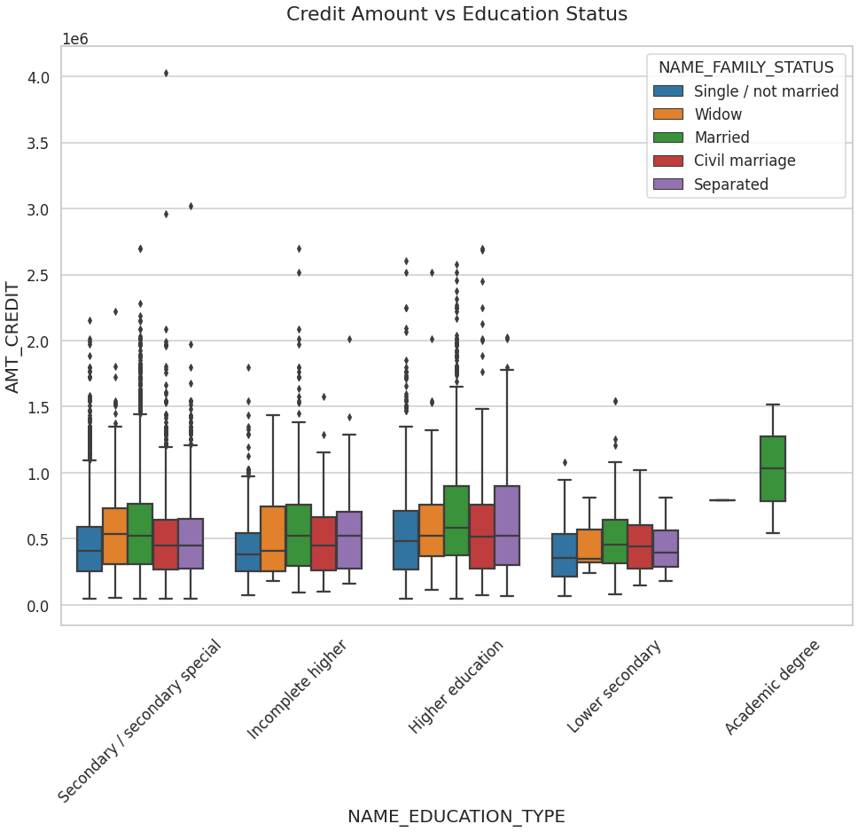
Credit amount vs Education Status
Few points can be concluded from the graph.
For education type 'Higher education' the income amount is mostly equal with family status except for married and widow
Most of the outliers are from Education type 'Higher education' and 'Secondary’.
For academic degree, only married is having most of the credits but higher than other education brackets.

Slide 28
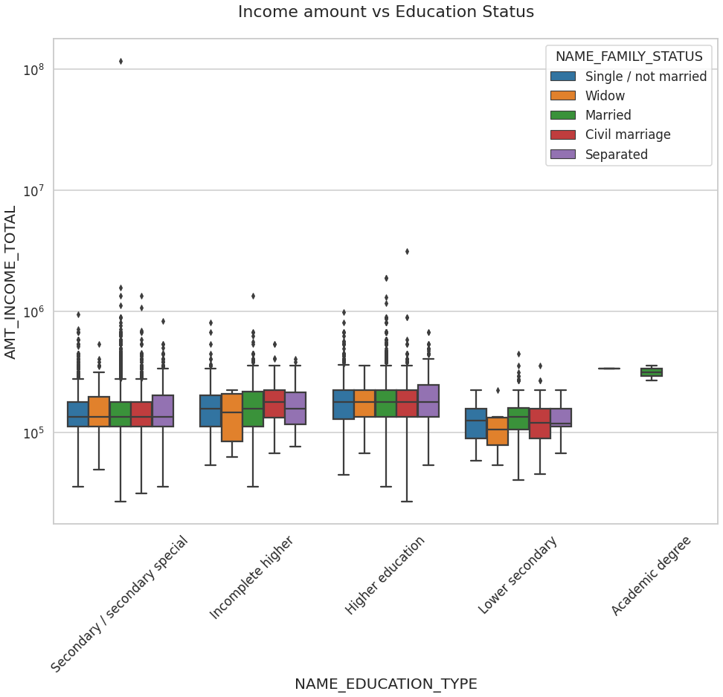
Income amount vs Education Status
Few points can be concluded from the graph.
The boxplot for Education type explains 'Higher education' income amount is mostly equal with family status.
Less outlier are having for Academic degree, but their income amount is little higher that Higher education.
Lower secondary are having less income amount than others.
For Academic degree holders, the family status is mostly married and have higher income compared to other education status

Slide 29
Data Cleaning –II Previous application
The initial dimension was 37 columns and 1670214 rows
15 columns had more than 30% missing values and were dropped
The Column “NAME_CASH_ON_PURPOSE” had XNA and XAP values and these rows were dropped
Final cleaned dimension with 22 columns and 69635 columns.
Finally Inner Joined on Application data on SK_ID_CURR

Slide 30
Univariate analysis (after merging previous application data)

Slide 31
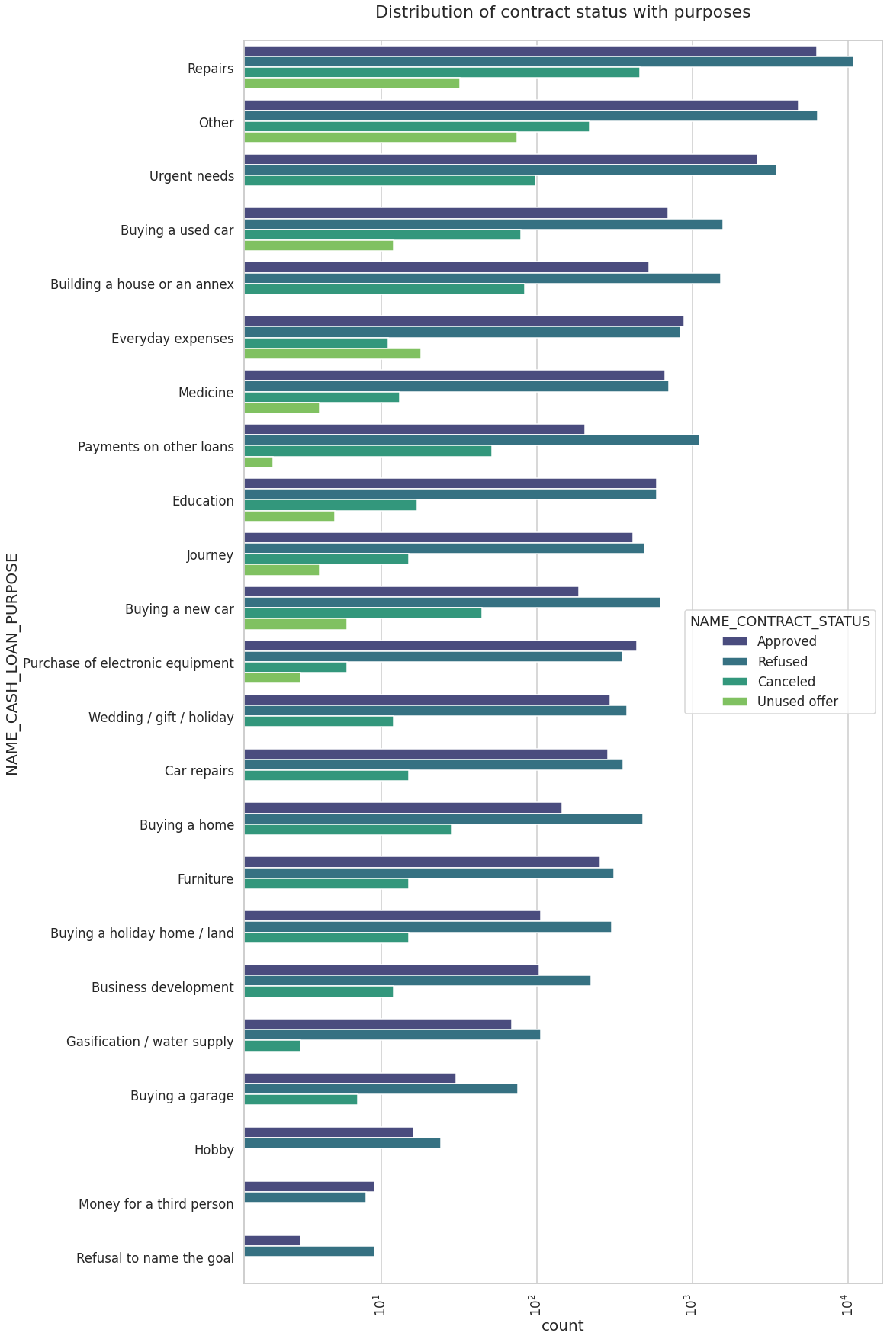
Distribution of contract status with purposes
Few points can be concluded from the graph.
Most rejection of loans came from purpose 'repairs'.
For education purposes we have equal number of approves and rejection
Paying other loans and buying a new car is having significant higher rejection than approves.

Slide 32
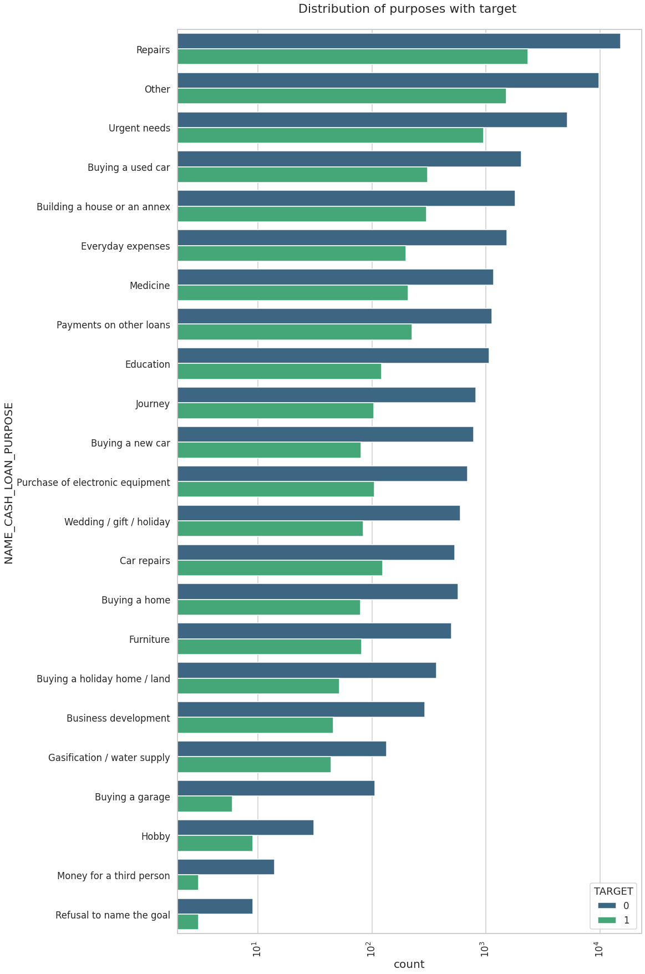
Distribution of purposes with target
Few points can be concluded from the graph.
Loan purposes with 'Repairs' are facing more difficulties in payment on time.
There are few places where loan payment is significantly higher than facing difficulties. They are 'Buying a garage', 'Business development', 'Buying land’, 'Buying a new car' and 'Education' Hence we can focus on these purposes for which the client is having for minimal payment difficulties.

Slide 33
Bivariate analysis

Slide 34
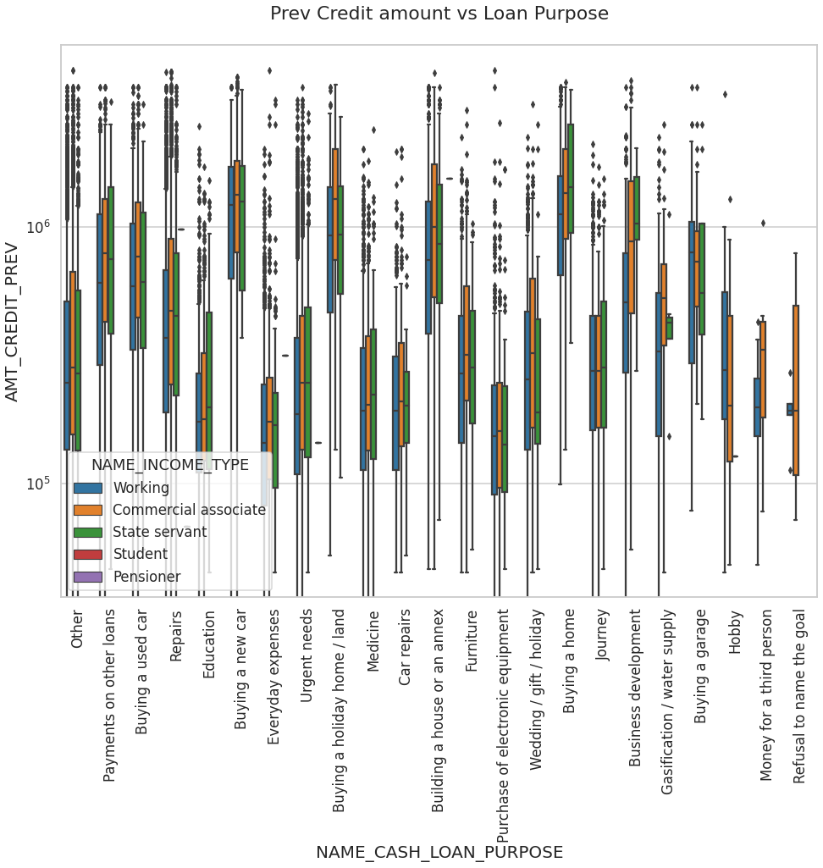
Prev Credit amount vs Loan Purpose
From the previous graph we can conclude the below points:
The credit amount of Loan purposes like 'Buying a home’, ’Buying a land’, 'Buying a new car' and ‘Building a house' is higher.
Income type of state servants have a significant amount of credit applied
Money for third person or a Hobby is having less credits applied for.

Slide 35
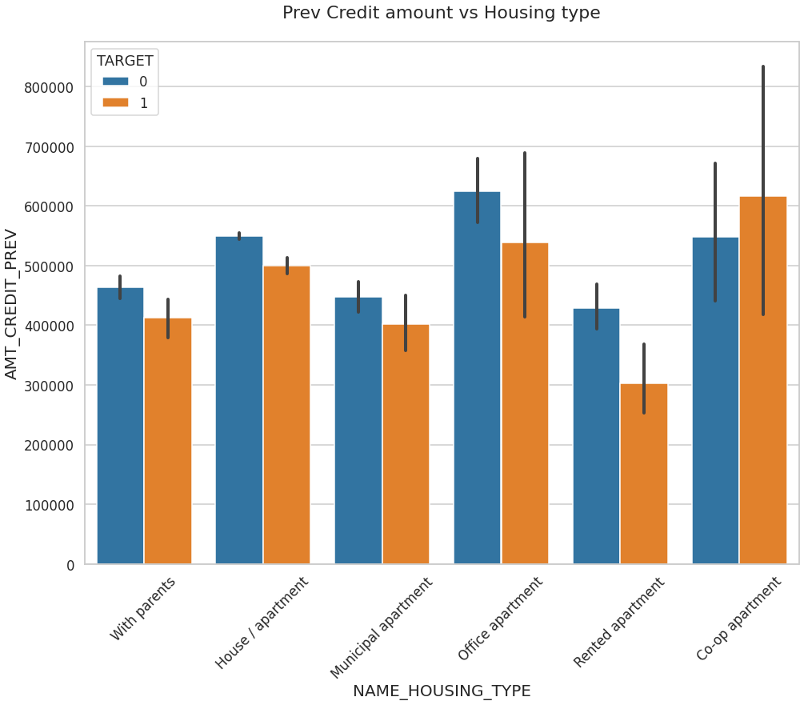
Prev Credit amount vs Housing type
Few points can be concluded from the graph.
Here for Housing type, office apartment is having higher credit of target 0 and co-op apartment is having higher credit of target 1.
So, we can conclude that bank should avoid giving loans to the housing type of co-op apartment as they are having difficulties in payment.
Bank can focus mostly on housing type with parents or House\apartment or municipal apartment for successful payments.

Slide 36
Conclusion
Banks should focus more on contract type ‘Student’ ,’pensioner’ and ‘Businessman’ with housing ‘type other than ‘Co-op apartment’ for successful payments.
Banks should focus less on income type ‘Working’ as they are having the greatest number of unsuccessful payments.
Also, with loan purpose ‘Repair’ is having higher number of unsuccessful payments on time.
Get as much as clients from housing type ‘With parents’ as they are having least number of unsuccessful payments.

